Slide 1
Assignment 2:
POVs and Experience Prototypes

Slide 2

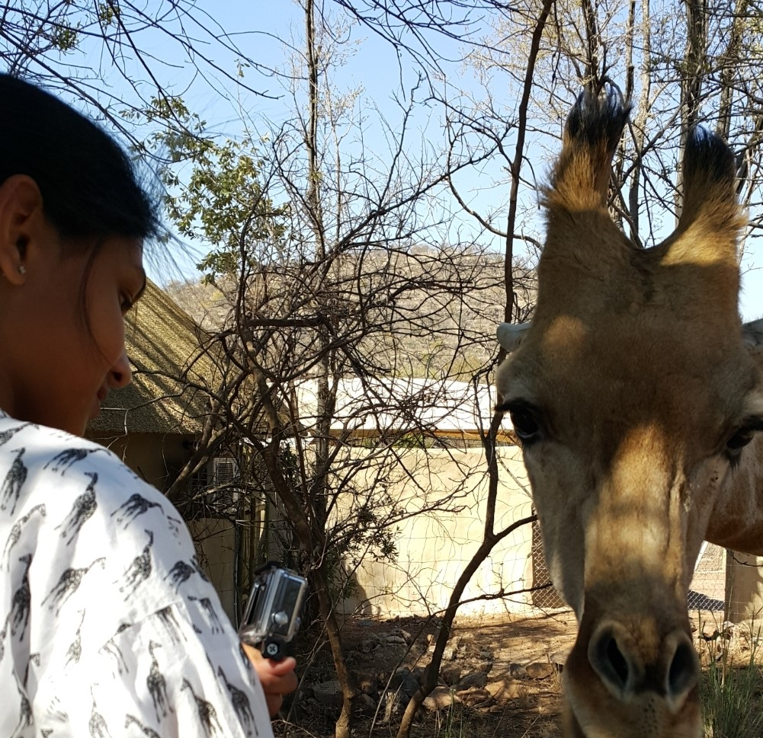


Our Team
Kaili W Kiara N Robert R George Y
Studio Theme: Financial Health and Literacy

Slide 3


Recap
Personal Finance
Personal struggles with handling finance
Younger
Individuals

Slide 4


Problem Domain
Small business owners
Business Finance
Personal Finance
Personal struggles with handling finance
Younger
Individuals
Startup related finance

Slide 5
Initial POV
*Note this POV was personal finance focussed
We met Will, a student at Georgia Tech studying Computer Science, with an expressed personal interest in financial health
We were amazed to realize he felt very incompetent with his finance knowledge in stocks despite being able to navigate stock market investments
It would be game-changing to give Will a way to better deal with the stock market with a medium that makes him feel competent

Slide 6
Initial POV
*Note this POV was personal finance focussed
We met Will, a student at Georgia Tech studying Computer Science, with an expressed personal interest in financial health
We were amazed to realize he felt very incompetent with his finance knowledge in stocks despite being able to navigate stock market investments
It would be game-changing to give Will a way to better deal with the stock market with a medium that makes him feel competent

Slide 7
Initial POV
*Note this POV was personal finance focussed
We met Will, a student at Georgia Tech studying Computer Science, with an expressed personal interest in financial health
We were amazed to realize he felt very incompetent with his finance knowledge in stocks despite being able to navigate stock market investments
It would be game-changing to give Will a way to better deal with the stock market with a medium that makes him feel competent

Slide 8
Needfinding Part 2
Small businesses

Slide 9
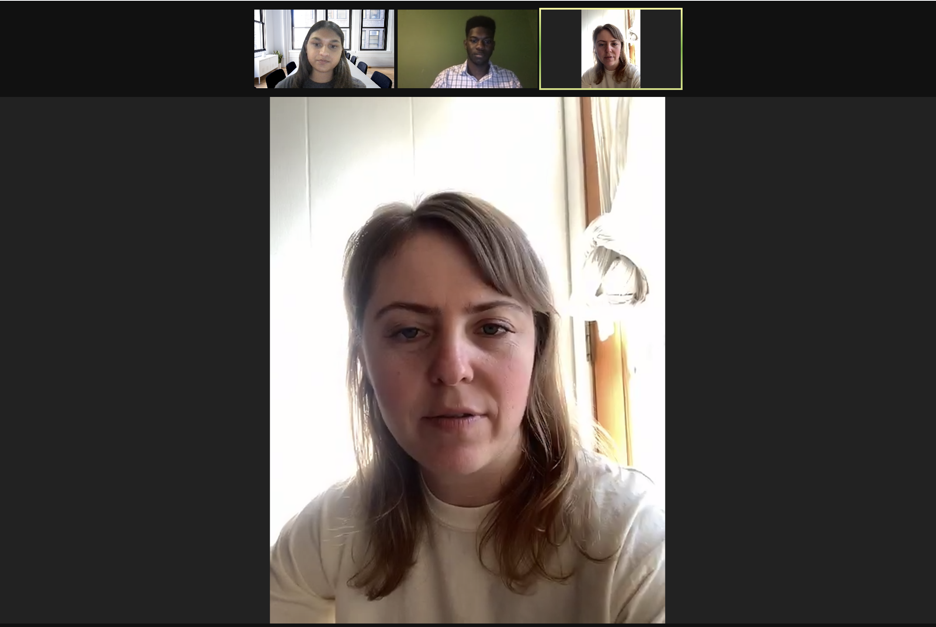
Meet: Gia Bahm
Founder and CEO of Unearthen
LA based handmade jewelry brand
Focussed on custom rings and showcase pieces that Gia makes herself

Slide 10
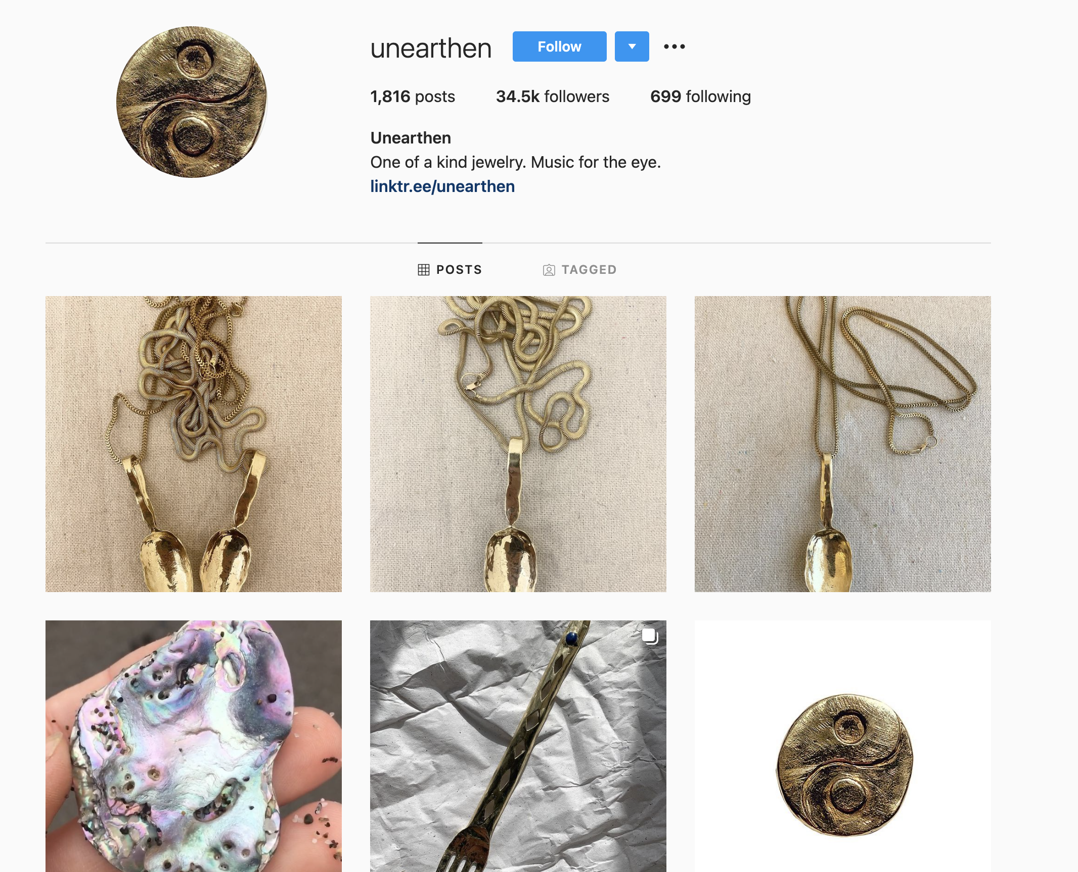


"I mostly focus on my online business presence and use Instagram as a tool for engagement"
Meet: Gia Bahm

Slide 11
"I mostly focus on my online business presence and use Instagram as a tool for engagement"
Meet: Gia Bahm
Currently puts much more attention into her custom design channels instead of wholesale

Slide 12
"I mostly focus on my online business presence and use Instagram as a tool for engagement"
Meet: Gia Bahm
Currently puts much more attention into her custom design channels instead of wholesale
"Right now I use my house as a workspace and consultation studio"

Slide 13
Despite the exponential increasing use of tools that allow businesses to operate completely virtually, many small businesses still need a physical space they can use to work on their craft and interact with customers

Slide 14
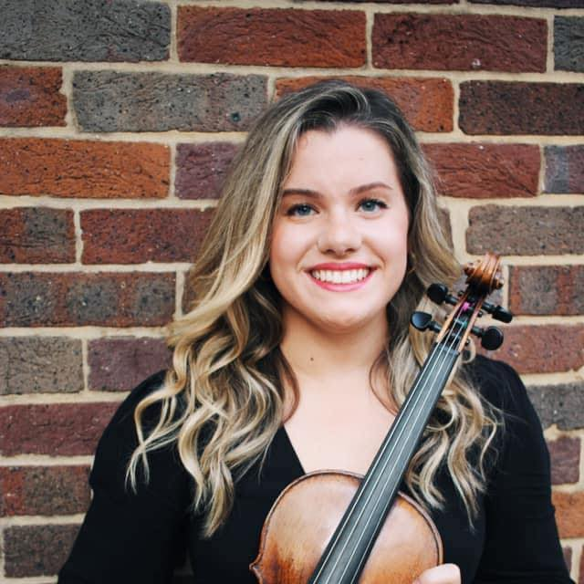
Meet: Chloe Harvel
Violin teacher
Runs her own studio teaching children and young adults
Based in Nashville, TN
Part-time nanny

Slide 15
Client Accountability
Chloe describes herself as a "people pleaser" and often experiences difficulty keeping her clients accountable to make payments for their classes on time
There is anxiety associated with following up with client payments by small business owners

Slide 16
Client Accountability
Chloe describes herself as a "people pleaser" and often experiences difficulty keeping her clients accountable to make payments for their classes on time
There is anxiety associated with following up with client payments by small business owners
Financial Organization
Chloe keeps track of her current clients in a physical planner
Constructs by hand monthly payment plans for each of her students in order to keep her finances secure

Slide 17
Revised POVs
Across all our interviews

Slide 18

POV 1
*Note this POV was from our first round of interviews
We met Andrew, a college-aged entrepreneur responsible for the finances of his healthcare startup including raising capital, issuing shares, filing taxes, budgeting and payroll in addition to his own personal finances
We were amazed to realize he does not fully understand taxes, despite having exposure to personal finance from a young age; he had to start from the very beginning learning everything he knows about taxes online
It would be game-changing to make the process of doing taxes (both personally and in the startup) more digestible for him
Notes:
HMW eliminate the need for him to fully understand taxes?
HMW help him better understand his taxes?
HMW help him avoid taxes?
HMW change the way in which a person thinks about filing taxes?
HMW automate the tax upkeep process?
HMW create a community around tax education that individuals could leverage during the tax filing process?
HMW make taxes something people are truly motivated to learn about?
HMW connect individuals more easily with tax experts or other who know more about taxes than they do?
HMW reduce the second derivative of the learning curve for taxes?
HMW supply startups with everything they need to do taxes in an easily accessible manner?

Slide 19
POV 1
*Note this POV was from our first round of interviews
We met Andrew, a college-aged entrepreneur responsible for the finances of his healthcare startup including raising capital, issuing shares, filing taxes, budgeting and payroll in addition to his own personal finances
We were amazed to realize he does not fully understand taxes, despite having exposure to personal finance from a young age; he had to start from the very beginning learning everything he knows about taxes online
It would be game-changing to make the process of doing taxes (both personally and in the startup) more digestible for him
Notes:
HMW eliminate the need for him to fully understand taxes?
HMW help him better understand his taxes?
HMW help him avoid taxes?
HMW change the way in which a person thinks about filing taxes?
HMW automate the tax upkeep process?
HMW create a community around tax education that individuals could leverage during the tax filing process?
HMW make taxes something people are truly motivated to learn about?
HMW connect individuals more easily with tax experts or other who know more about taxes than they do?
HMW reduce the second derivative of the learning curve for taxes?
HMW supply startups with everything they need to do taxes in an easily accessible manner?

Slide 20
POV 1
*Note this POV was from our first round of interviews
We met Andrew, a college-aged entrepreneur responsible for the finances of his healthcare startup including raising capital, issuing shares, filing taxes, budgeting and payroll in addition to his own personal finances
We were amazed to realize he does not fully understand taxes, despite having exposure to personal finance from a young age; he had to start from the very beginning learning everything he knows about taxes online
It would be game-changing to make the process of doing taxes (both personally and in the startup) more digestible for him
Notes:
HMW eliminate the need for him to fully understand taxes?
HMW help him better understand his taxes?
HMW help him avoid taxes?
HMW change the way in which a person thinks about filing taxes?
HMW automate the tax upkeep process?
HMW create a community around tax education that individuals could leverage during the tax filing process?
HMW make taxes something people are truly motivated to learn about?
HMW connect individuals more easily with tax experts or other who know more about taxes than they do?
HMW reduce the second derivative of the learning curve for taxes?
HMW supply startups with everything they need to do taxes in an easily accessible manner?

Slide 21
POV 2
We met Gia, an online jewelry store owner and custom ring maker based in Los Angeles
We were amazed to realize that Gia is anxious about incorporating a physical store and showroom with a workspace into her online business model especially with regards to the upfront cost and if her target market would be accessible with her new space
It would be game-changing to reduce the anxiety before signing before signing a long-term lease and transition part of her business into a physical space
Notes:
HMW provide Gia with a way to understand how accessible her target market would be through her new physical space before signing a lease?
HMW combine the financials relevant to both Gia's online store and physical store in a way that she can easily understand and make important decisions with?
HMW connect Gia with reliable, efficient and recommended contractors and interior designers that can help her create her physical space?
HMW create a platform to display the most updated property information that Gia could leverage?
HMW help Gia feel more confident about making her customers feel at home transitioning from an online model to a physical store?
HMW show Gia how owning a physical store might affect the business as a whole?
HMW help Gia not feel the need to have physical store front to show her products and provide herself with a workspace?
HMW show Gia how certain major decisions/changes (like owning a physical store) might affect the business as a whole?
HMW allow Gia to take advantage of micro-leases to reduce the anxiety of an expensive long-term lease?
HMW combine the financials relevant to both Gia's online store and physical store in a way that she can easily understand and make important decisions with?

Slide 22
POV 2
We met Gia, an online jewelry store owner and custom ring maker based in Los Angeles
We were amazed to realize that Gia is anxious about incorporating a physical store and showroom with a workspace into her online business model especially with regards to the upfront cost and if her target market would be accessible with her new space
It would be game-changing to reduce the anxiety before signing before signing a long-term lease and transition part of her business into a physical space
Notes:
HMW provide Gia with a way to understand how accessible her target market would be through her new physical space before signing a lease?
HMW combine the financials relevant to both Gia's online store and physical store in a way that she can easily understand and make important decisions with?
HMW connect Gia with reliable, efficient and recommended contractors and interior designers that can help her create her physical space?
HMW create a platform to display the most updated property information that Gia could leverage?
HMW help Gia feel more confident about making her customers feel at home transitioning from an online model to a physical store?
HMW show Gia how owning a physical store might affect the business as a whole?
HMW help Gia not feel the need to have physical store front to show her products and provide herself with a workspace?
HMW show Gia how certain major decisions/changes (like owning a physical store) might affect the business as a whole?
HMW allow Gia to take advantage of micro-leases to reduce the anxiety of an expensive long-term lease?
HMW combine the financials relevant to both Gia's online store and physical store in a way that she can easily understand and make important decisions with?

Slide 23
POV 2
We met Gia, an online jewelry store owner and custom ring maker based in Los Angeles
We were amazed to realize that Gia is anxious about incorporating a physical store and showroom with a workspace into her online business model especially with regards to the upfront cost and if her target market would be accessible with her new space
It would be game-changing to reduce her anxiety before signing a long-term lease and transition part of her business into a physical space
Notes:
HMW provide Gia with a way to understand how accessible her target market would be through her new physical space before signing a lease?
HMW combine the financials relevant to both Gia's online store and physical store in a way that she can easily understand and make important decisions with?
HMW connect Gia with reliable, efficient and recommended contractors and interior designers that can help her create her physical space?
HMW create a platform to display the most updated property information that Gia could leverage?
HMW help Gia feel more confident about making her customers feel at home transitioning from an online model to a physical store?
HMW show Gia how owning a physical store might affect the business as a whole?
HMW help Gia not feel the need to have physical store front to show her products and provide herself with a workspace?
HMW show Gia how certain major decisions/changes (like owning a physical store) might affect the business as a whole?
HMW allow Gia to take advantage of micro-leases to reduce the anxiety of an expensive long-term lease?
HMW combine the financials relevant to both Gia's online store and physical store in a way that she can easily understand and make important decisions with?

Slide 24
HMW 1:
How Might We provide Gia with a way to reduce her anxiety associated with expanding into a physical space?

Slide 25
HMW 2:
How Might We make Gia feel more secure in her decision to expand into a physical space to access her customers?

Slide 26
POV 3
We met Chloe, a young Southern violinist that teaches local kids and young adults the violin as a source of income
We were amazed to realize that she has trouble with keeping her clients accountable as a "people pleaser" and therefore often receive class payments late
It would be game-changing to enable her to stay financially organized with on-time client payments
Notes:
HMW develop a system of getting payment from her students?
HMW help her feel less awkward about confronting her students who haven’t paid her?
HMW incentivize clients to pay Chloe on time?
HMW keep her from feeling guilty when she is just doing her job to get paid?
HMW help her be less of a “people-pleaser”?
HMW entirely remove the burden of staying financially organized from her?
HMW reduce the anxiety surrounding collecting payments?
HMW provide automated reminders to keep both parties accountable?
HMW provide education about interacting with clients?
HMW create a payment system for Chloe that doesn't require her to receive regular payments payments from her students?
HMW provide a way to keep her clients accountable without the need of reminding them coming from her?

Slide 27
POV 3
We met Chloe, a young Southern violinist that teaches local kids and young adults the violin as a source of income
We were amazed to realize that she has trouble with keeping her clients accountable as a "people pleaser" and therefore often receives class payments late
It would be game-changing to enable her to stay financially organized with on-time client payments
Notes:
HMW develop a system of getting payment from her students?
HMW help her feel less awkward about confronting her students who haven’t paid her?
HMW incentivize clients to pay Chloe on time?
HMW keep her from feeling guilty when she is just doing her job to get paid?
HMW help her be less of a “people-pleaser”?
HMW entirely remove the burden of staying financially organized from her?
HMW reduce the anxiety surrounding collecting payments?
HMW provide automated reminders to keep both parties accountable?
HMW provide education about interacting with clients?
HMW create a payment system for Chloe that doesn't require her to receive regular payments payments from her students?
HMW provide a way to keep her clients accountable without the need of reminding them coming from her?

Slide 28
POV 3
We met Chloe, a young Southern violinist that teaches local kids and young adults the violin as a source of income
We were amazed to realize that she has trouble with keeping her clients accountable as a "people pleaser" and therefore often receives class payments late
It would be game-changing to enable her to stay financially organized with on-time client payments
Notes:
HMW develop a system of getting payment from her students?
HMW help her feel less awkward about confronting her students who haven’t paid her?
HMW incentivize clients to pay Chloe on time?
HMW keep her from feeling guilty when she is just doing her job to get paid?
HMW help her be less of a “people-pleaser”?
HMW entirely remove the burden of staying financially organized from her?
HMW reduce the anxiety surrounding collecting payments?
HMW provide automated reminders to keep both parties accountable?
HMW provide education about interacting with clients?
HMW create a payment system for Chloe that doesn't require her to receive regular payments payments from her students?
HMW provide a way to keep her clients accountable without the need of reminding them coming from her?

Slide 29
HMW 3:
How Might We provide a way to keep her clients accountable without the burden of reminding them to pay coming from her?

Slide 30
Solution 1
Also provide reliable local recommendations
A web app that will facilitate and organize the transition for small business owners into physical spaces
Flexible for both micro-leases and long-term leases on store fronts
Budgeting tool to keep track of:
rent expenses
contractor pricing
interior designers
point of sale equipment

Slide 31
Prototype 1
Assumption to test
It is a difficult process to organize and budget the setting up of a storefront.

Slide 32
Prototype 1
Assumption to test
It is a difficult process to organize and budget the setting up of a storefront
The Prototype
A slideshow with tasks that required the participant to share their screen and demonstrate how one would achieve each activity

Slide 33
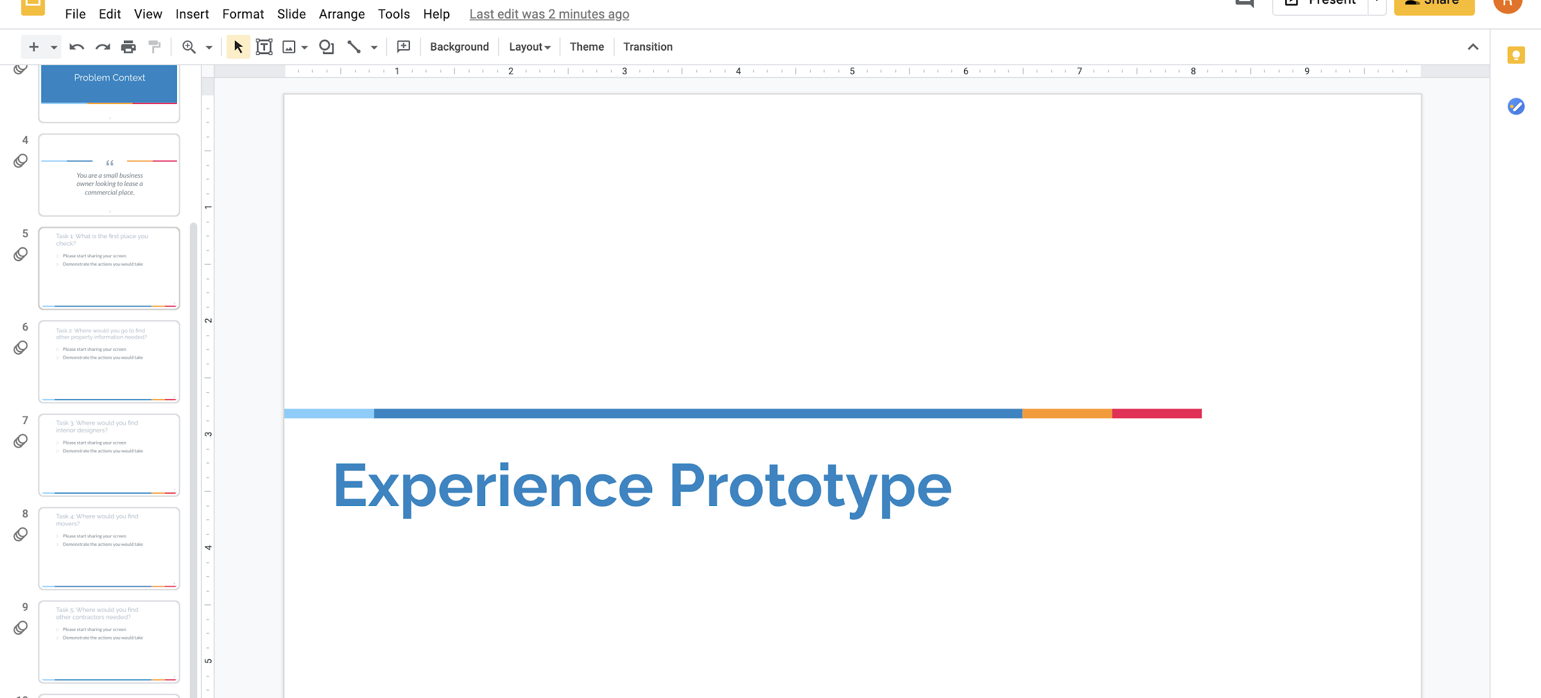
Prototype 1
Tasks that are required in the process of finding commercial properties, contractors and staying within a budget whilst doing so

Slide 34
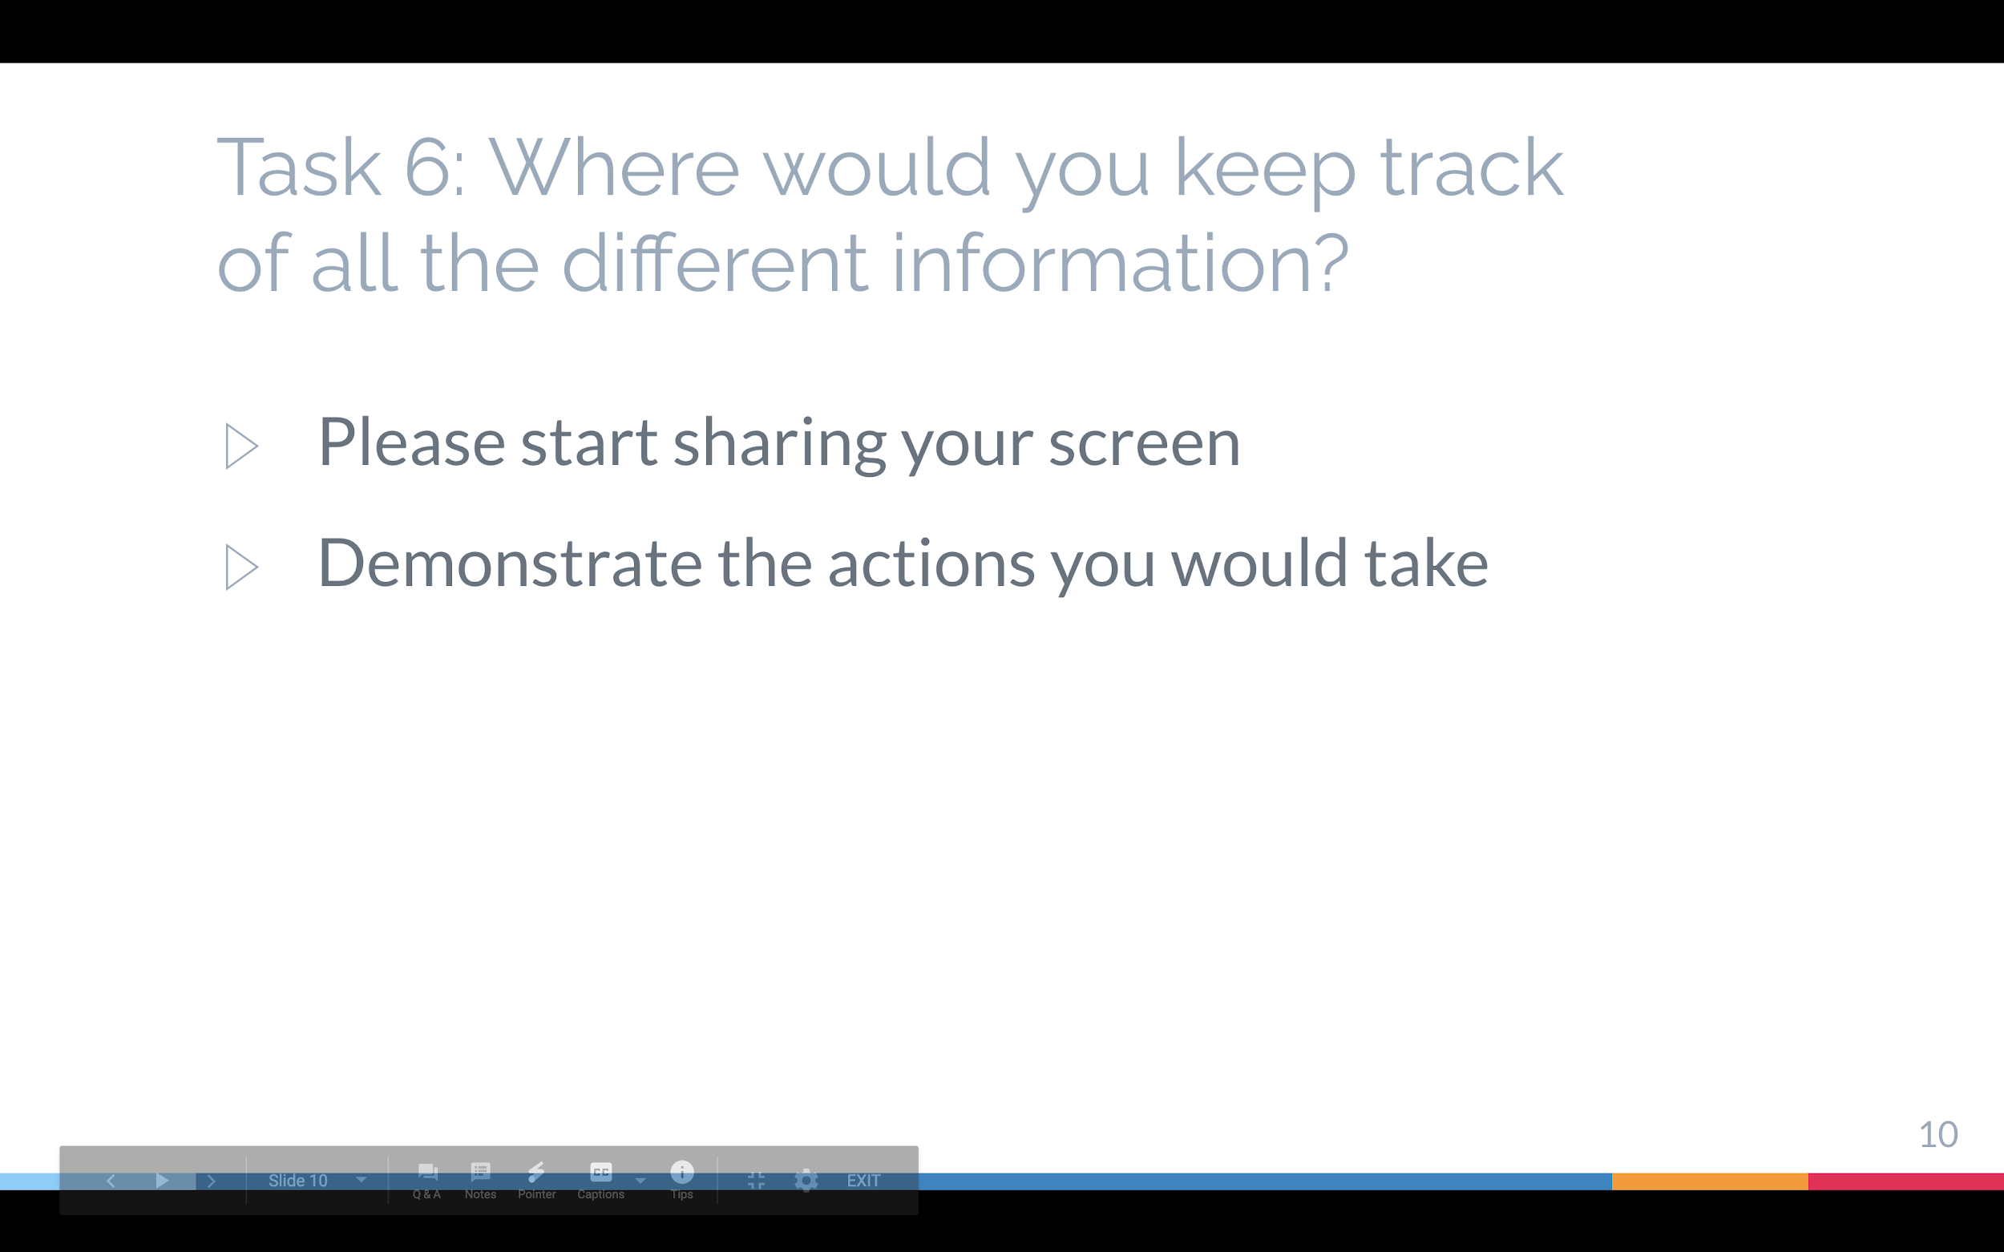
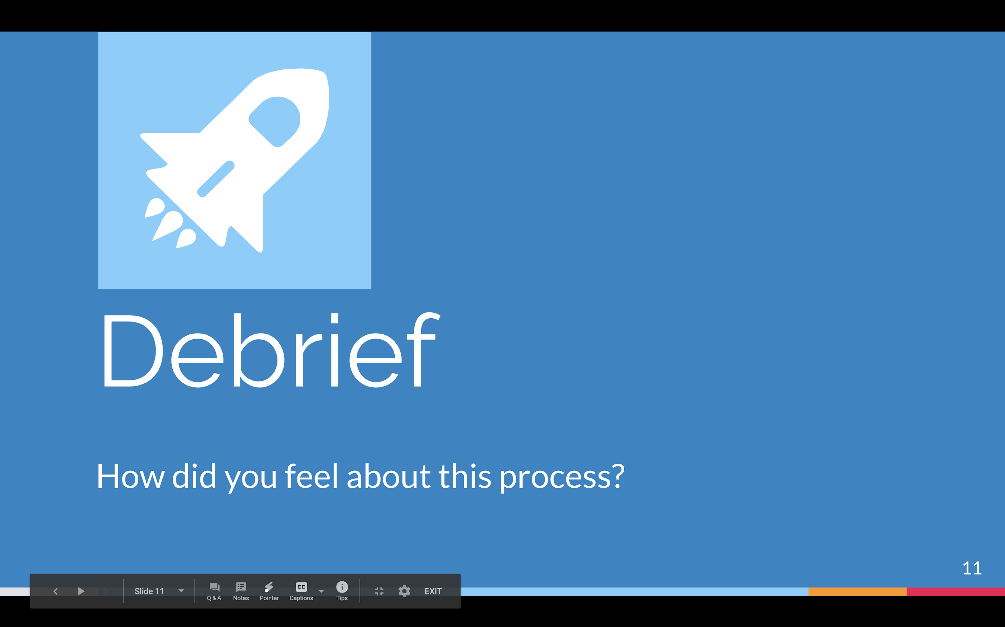
Prototype 1

Slide 35
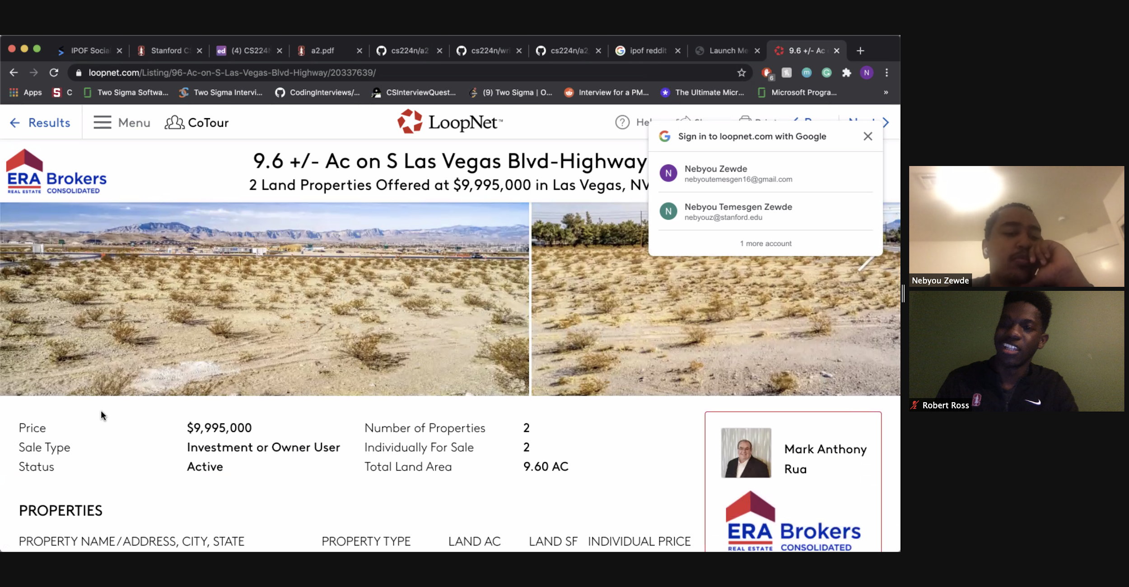
Prototype 1 - test
Nebyou felt that there was an overwhelming amount of information not relevant to the property
Difficult to compare between contractors
Difficult to maintain order within Google Docs as the properties increased
Insightful that the initial step of utilizing Google to search the best and most trusted contractors was repeated
Nebyou, a college student with financial analyst experience

Slide 36
Prototype 1 - test
Nebyou felt that there was an overwhelming amount of information not relevant to the property
Difficult to compare between contractors
Difficult to maintain order within Google Docs as the properties increased
Insightful that the initial step of utilizing Google to search the best and most trusted contractors was repeated
Assumption proven
Nebyou, a college student with financial analyst experience

Slide 37
Solution 2
A mobile application that attracts target markets closer to small businesses to ensure that physical store-fronts do indeed draw in their customer base as expected
Inspired by "Pokemon GO," clustering people around different points of interest in order for them to receive something in return
Customers will be pinged about offerings:
Time based discounts
Challenge related special giveaways

Slide 38
Prototype 2
Assumption to test
People will go to a store they’ve never heard about, just because an app recommended

Slide 39
Prototype 2
Assumption to test
People will go to a store they’ve never heard about, just because an app recommended
The Prototype
A choose-your-adventure group of scenarios for the user to go through while screen sharing made with screens designed in Figma

Slide 40
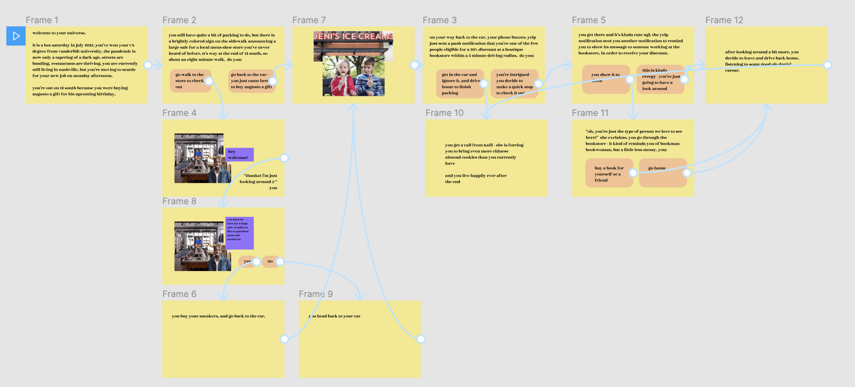
Prototype 2
Scenarios of discovering discounts of new shops while walking in a commercial area

Slide 41
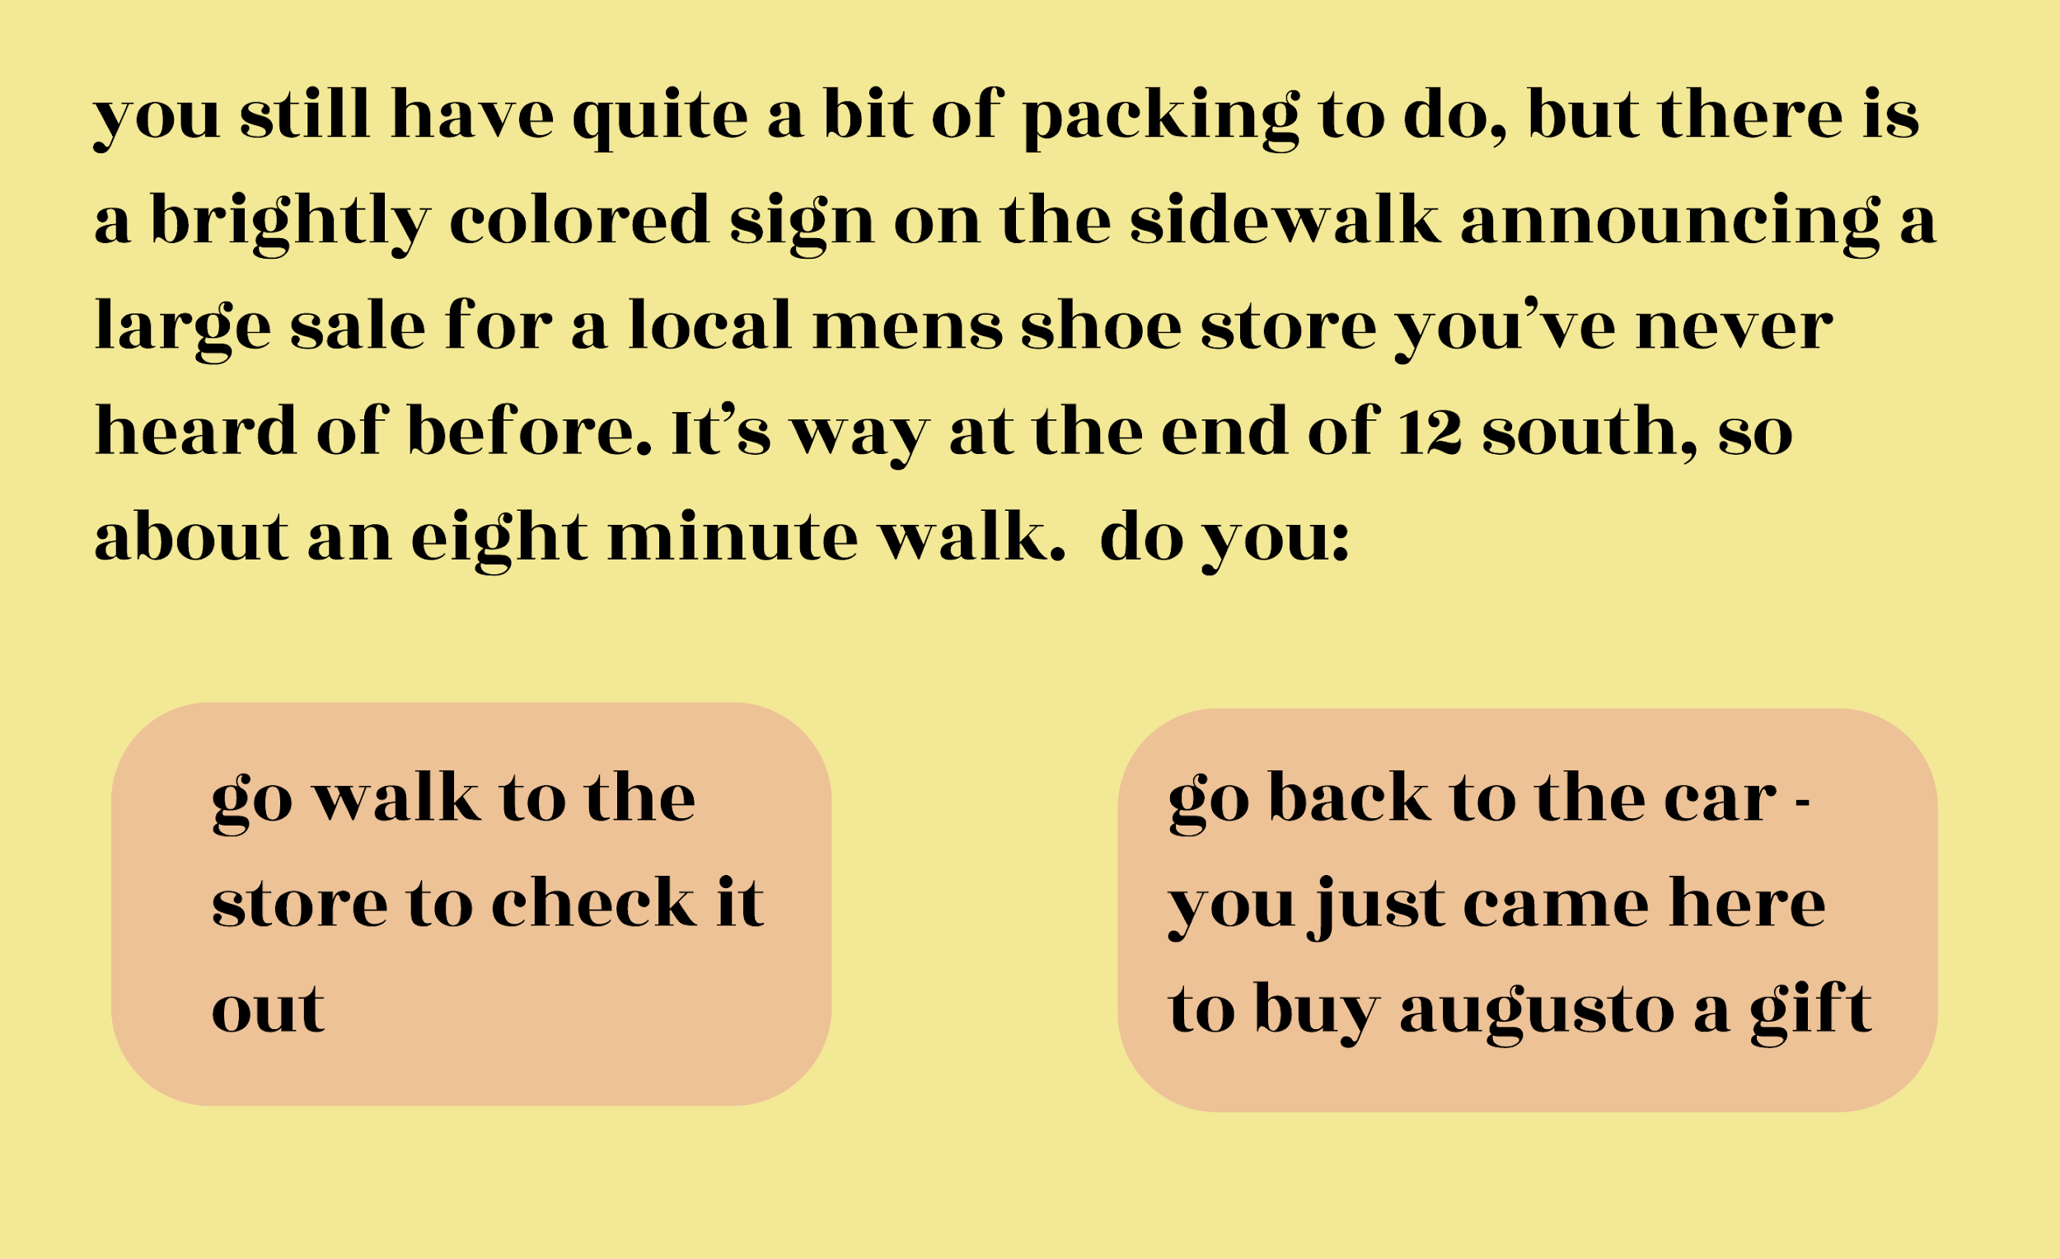
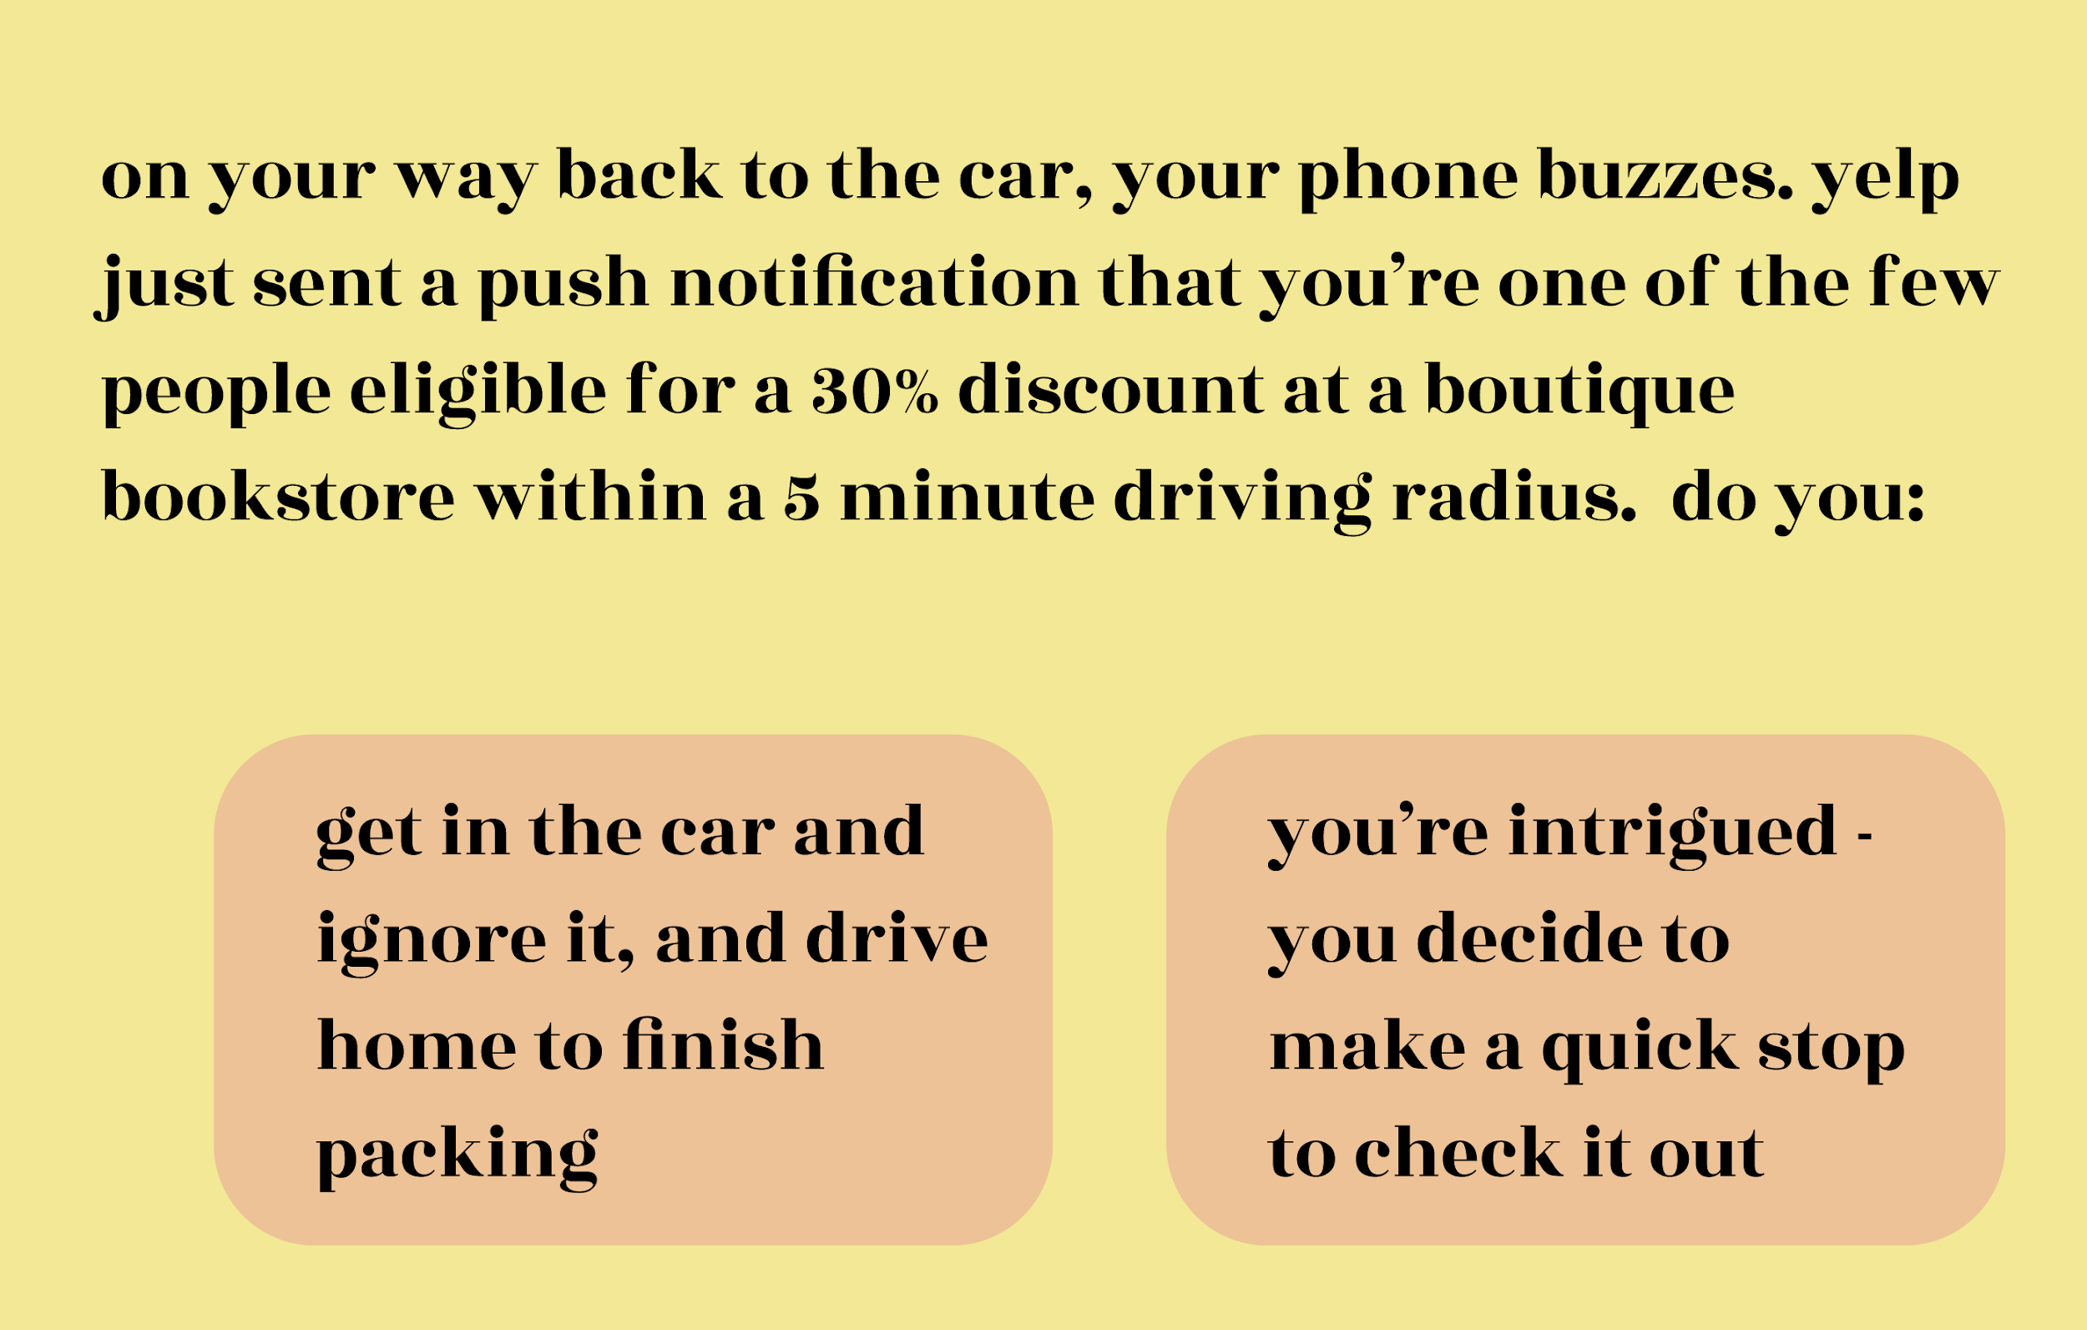
Prototype 2

Slide 42
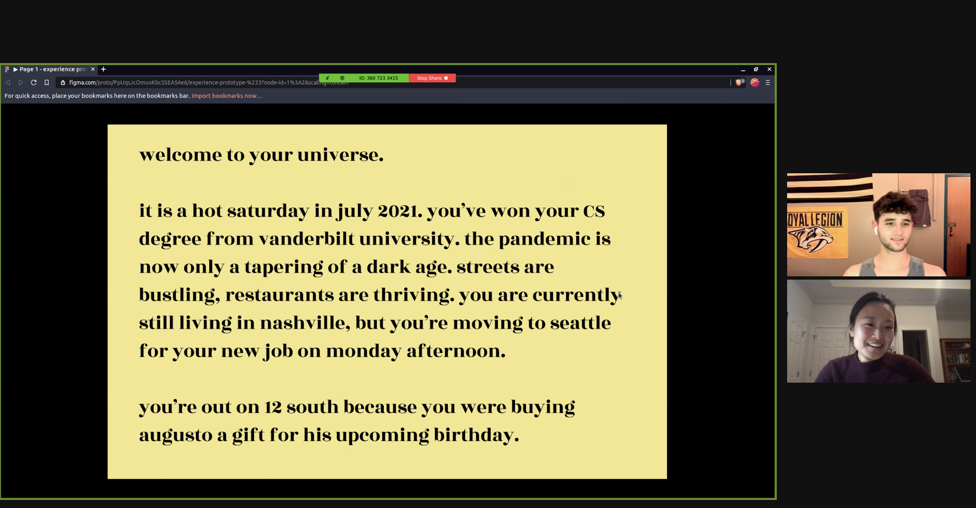
Prototype 2 - test
Sam was not interested in discovering a store because of a discount
Took the shortest path possible in every scenario
Did not want to buy anything even with different offers
Though he may not be representative of the whole population, this is a powerful and surprising insight
Sam, a male who generally does not enjoy shopping

Slide 43
Prototype 2 - test
Sam was not interested in discovering a store because of a discount
Took the shortest path possible in every scenario
Did not want to buy anything even with different offers
Though he may not be representative of the whole population, this is a powerful and surprising insight
Assumption disproven
Sam, a male who generally does not enjoy shopping

Slide 44
Solution 3
A platform that small businesses can use as turnkey solution to facilitate on-time client payments
Keeps track of clients and their payment schedules with automated reminders on late payments
Through a custom inputted "gamify" approach you're able to incentivise early payments by offering:
discounts on future offerings
credits on future purchases
access to other custom offerings a business owner chooses to provide

Slide 45
Prototype 3
Assumption to Test
Gamifying payments will incentivize clients to pay more up front for more lessons to earn rewards

Slide 46
Prototype 3
Assumption to Test
Gamifying payments will incentivize clients to pay more up front for more lessons to earn rewards
The Prototype
A Google Form asking the user questions about their behavior and decisions surrounding payment for services (and subsequent conversation about answers)

Slide 47
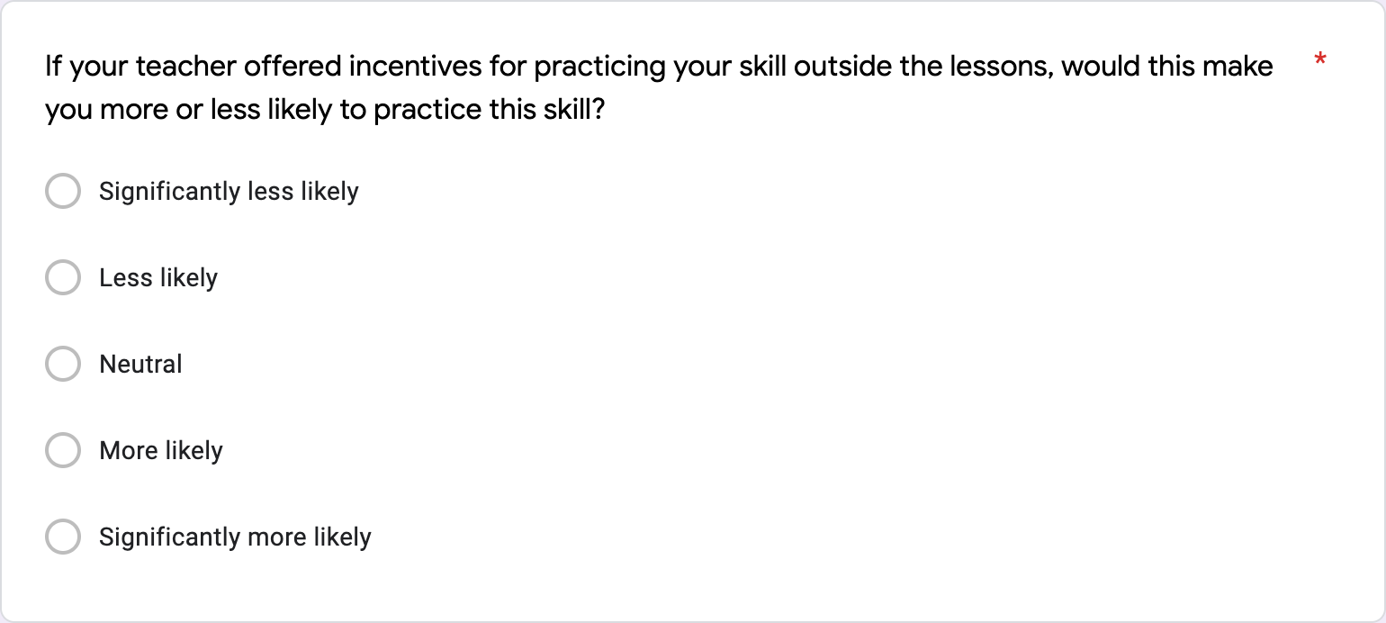
Prototype 3
Tasks that are required in the process of finding and paying for private lessons

Slide 48
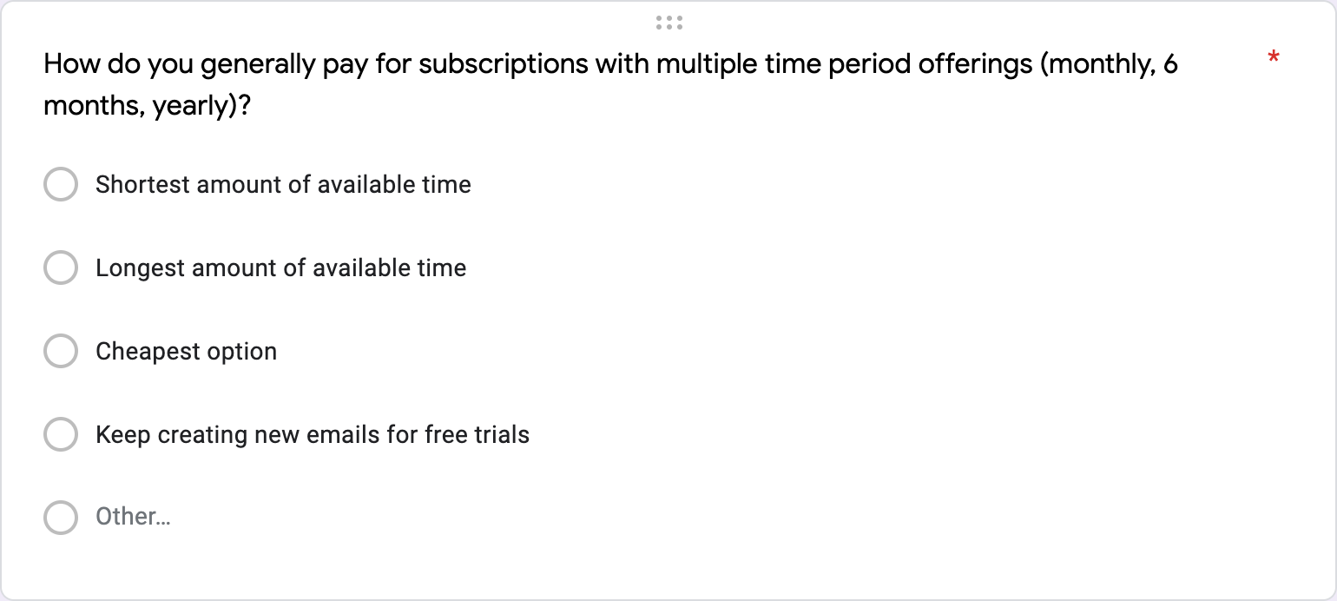
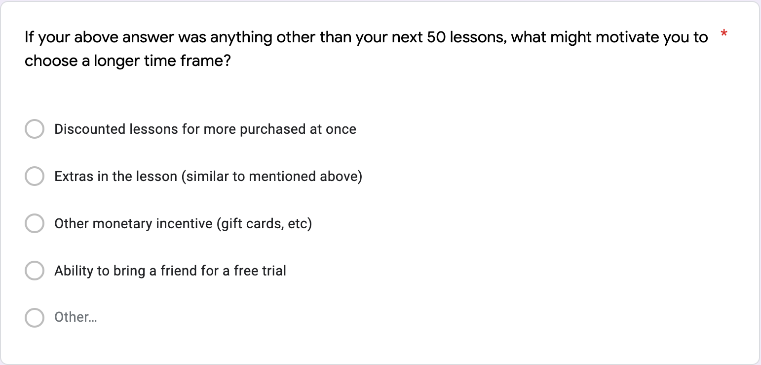
Prototype 3

Slide 49
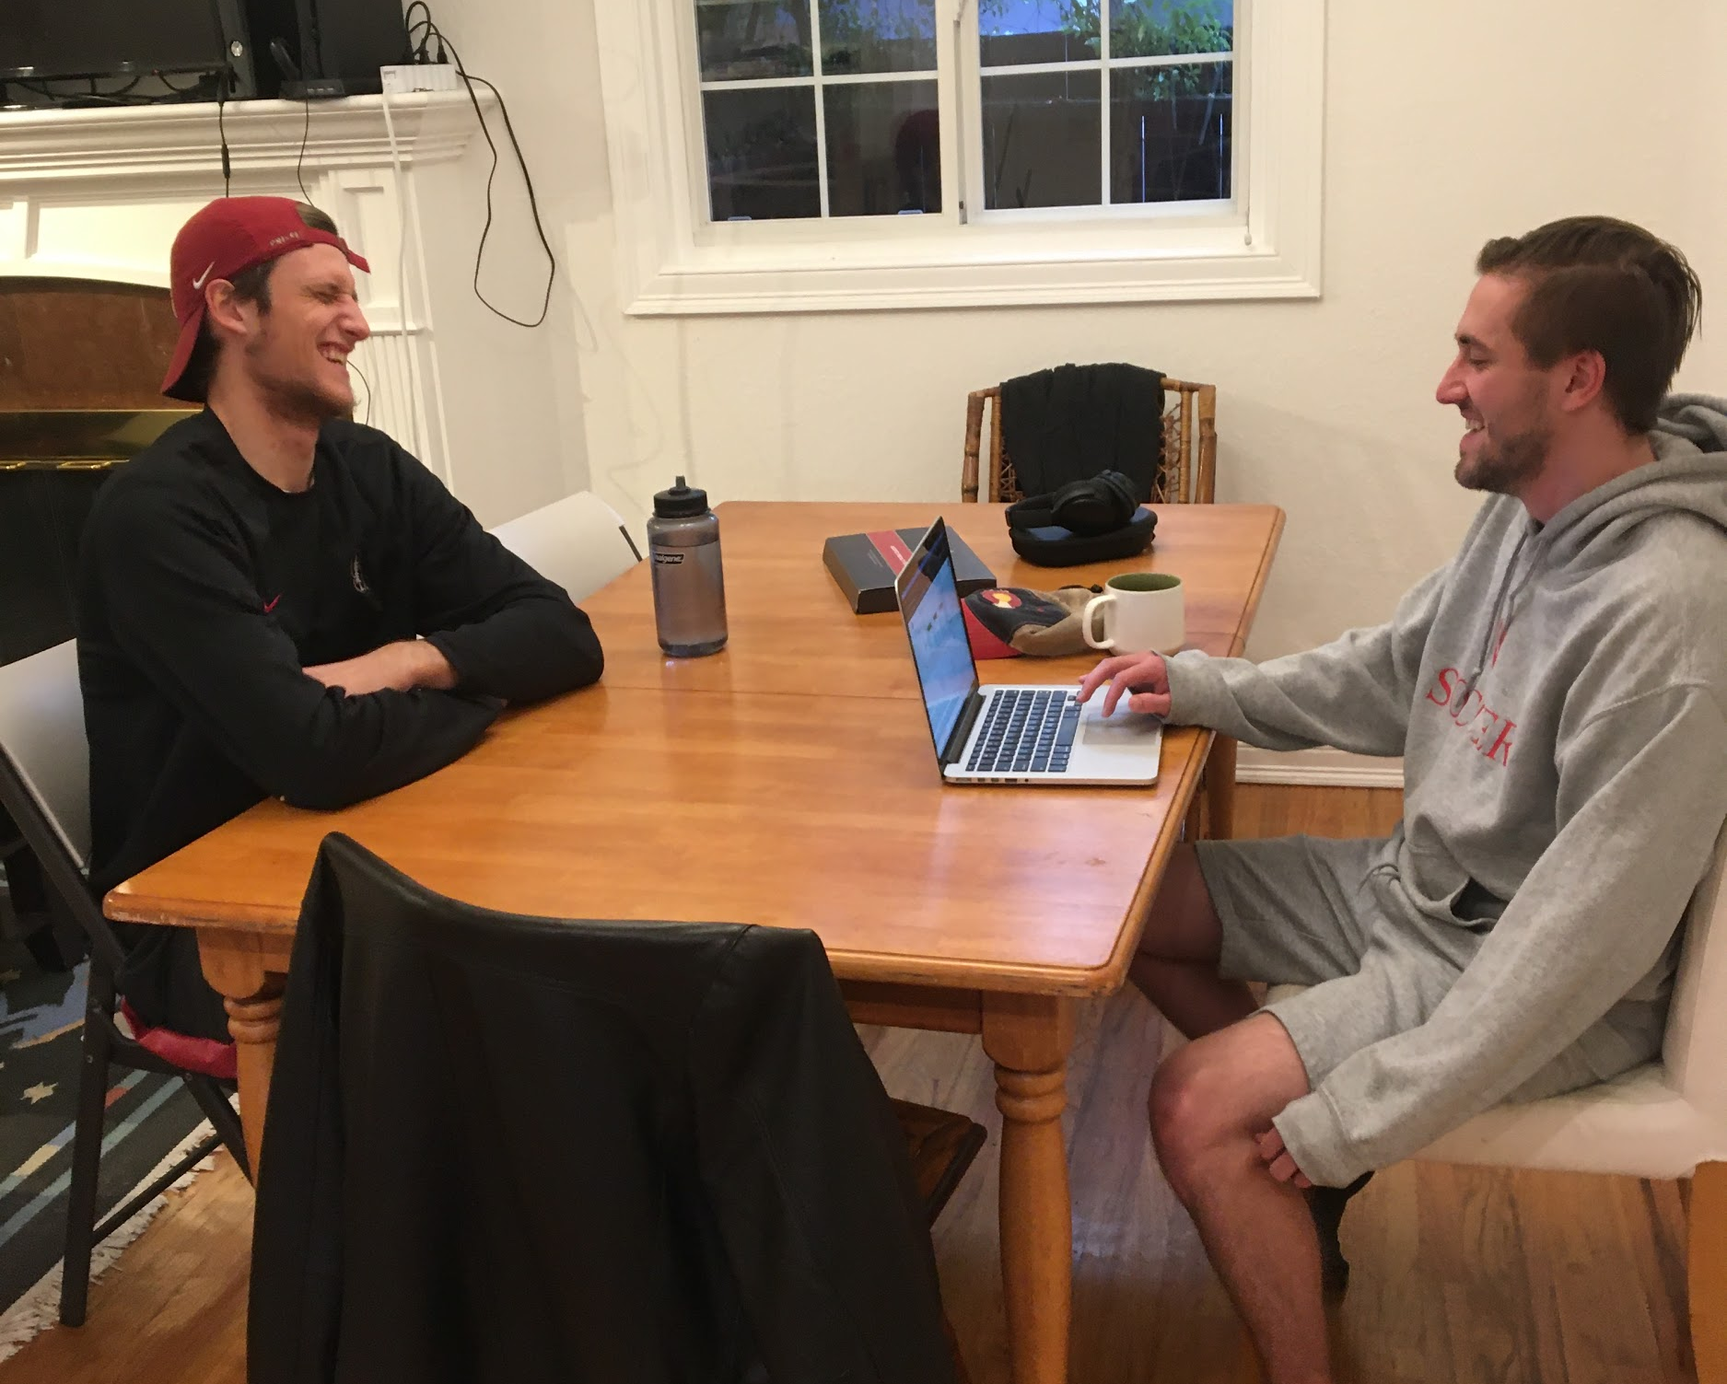
Prototype 3 - test
Although Blake would not be more likely to work on his skill outside lessons with incentives, discounted lessons were his #1 best incentive to pay more up front for more lessons
Cost was definitely his most important factor, so gamifying around helping him save money would be effective
Blake, is a college graduate who took private basketball lessons

Slide 50
Prototype 3 - test
Although Blake would not be more likely to work on his skill outside lessons with incentives, discounted lessons were his #1 best incentive to pay more up front for more lessons
Cost was definitely his most important factor, so gamifying around helping him save money would be effective
Assumption Proven
Blake, is a college graduate who took private basketball lessons

Slide 51
Solution Overview
Solution 1
There is a clear struggle experienced by individuals (even financially experienced tech-savvy ones) in navigating the process of setting up a physical store whether that be for a few hours/days (pop-up) or months (long-term).
We think our proposed solution would facilitate this process and reduce the associated anxiety by small businesses.

Slide 52
Solution Overview
Solution 1
There is a clear struggle experienced by individuals (even financially experienced tech-savvy ones) in navigating the process of setting up a physical store whether that be for a few hours/days (pop-up) or months (long-term).
We think our proposed solution would facilitate this process and reduce the associated anxiety by small businesses.
Solution 2
Based on our experience prototype, our assumption might have been incorrect.
In order to pursue this solution further, we would need to continue testing our associated assumptions.

Slide 53
Solution Overview
Solution 1
There is a clear struggle experienced by individuals (even financially experienced tech-savvy ones) in navigating the process of setting up a physical store whether that be for a few hours/days (pop-up) or months (long-term).
We think our proposed solution would facilitate this process and reduce the associated anxiety by small businesses.
Solution 2
Based on our experience prototype, our assumption might have been incorrect.
In order to pursue this solution further, we would need to continue testing our associated assumptions.
Solution 3
We found that individuals are motivated to pay on-time if they receive a discount. This might force the owner to offer these in order to just get paid.
We think our proposed solution can perhaps be adapted to focus at the same time on organizing on-time payments together with the "gamification" aspect

Slide 54
Summary
We started off looking at Personal Finance interviewing younger individuals and understanding their relationship with Finance
Understood that for small businesses the distinction between Personal and Business Finance is very much blurred
Small businesses experience unique challenges based on their industry
Interviewing Gia and Chloe has allowed us to narrow our scope that we are very interested in
Our proposed solutions are both novel and address the key problems we found
Next steps:
Continue testing other related assumptions
Get on another call with Gia and Chloe to get their feedback/input

Slide 55
Thanks!
Any questions ?
Kiara N, Kaili W, Robert R, George Y

Slide 56
Appendix

Slide 57
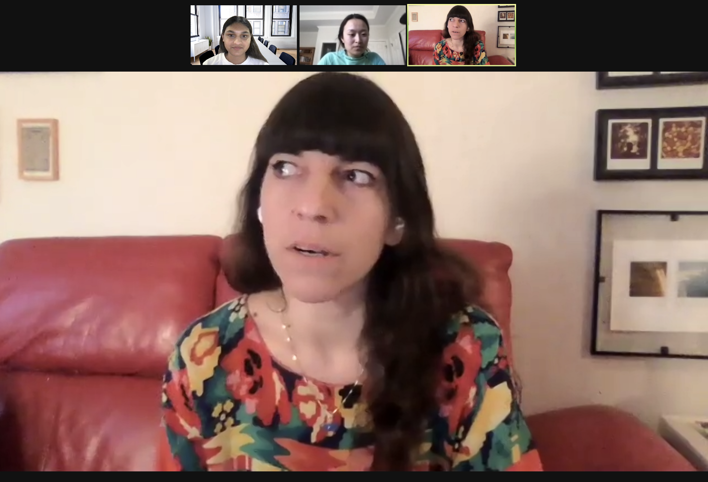

Additional Interviews
Owner of Dancorcism, an online dance studio
Based in New York
Multiple streams of income including private lessons
Tools: Venmo, Square and individual spreadsheets

Slide 58
Summary of Interviews and Other Findings
3 interviews with owners of small businesses
All focussed on different business verticals (some online focussed and others not)
Financial literacy is prioritized differently amongst different owners (some delegate it to a third party accountant)
Many have had to adapt into their businesses and during changing financial circumstances with multiple streams of income

